Slide 1
Generative adversarial networks (GAN)
Jaehyoung Hong

Slide 2
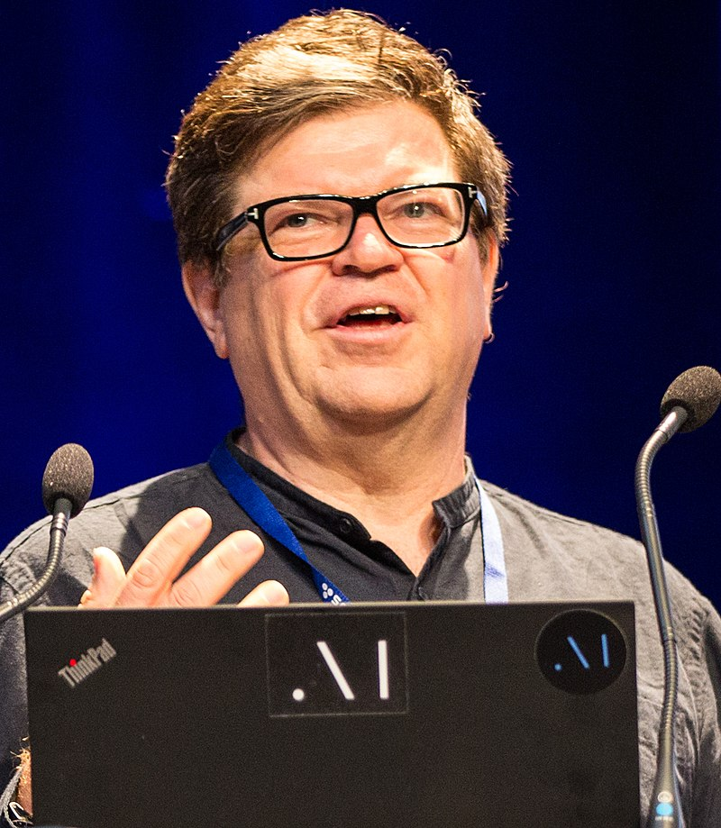
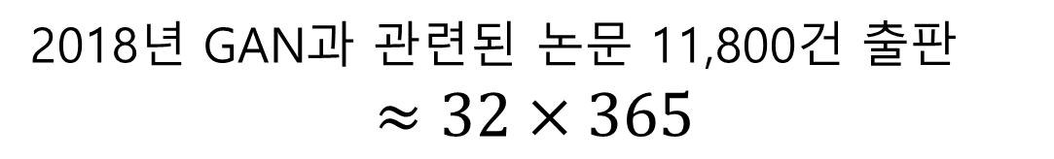
GAN have become a hot research topic recently
GANs are the most interesting idea in the last
10 years in machine learning
2018년 GAN과 관련된 논문 11,800건 출판
$$≈32×365$$
<Yann LeCun>

Slide 3
Motivation of GAN

Slide 4

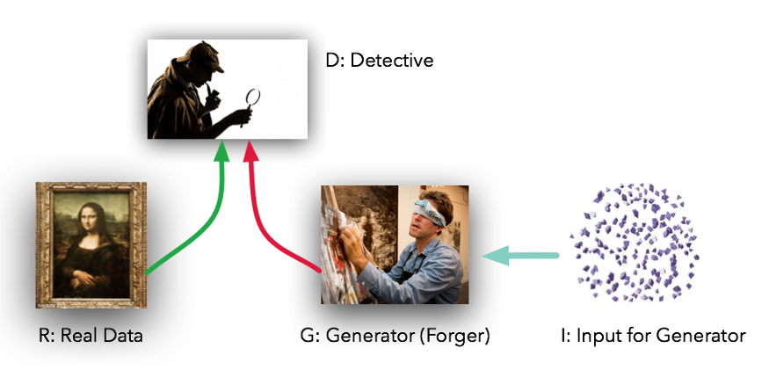



Idea of GAN : Forger and detective
Generator and discriminator can have any system (flexible)
GAN : Ian Goodfellow (2014)

Slide 5
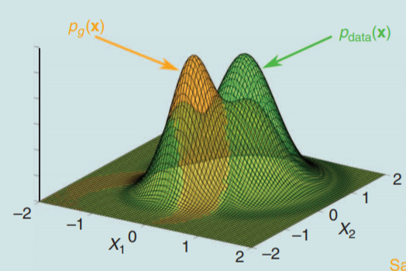
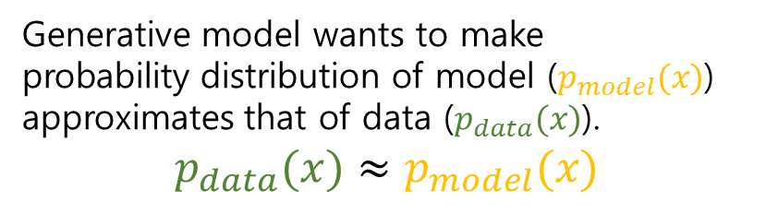
Generative algorithm wants to capture the probability distribution of data
Case1. Explicit density model
Density를 가정 (Gaussian, Poisson, …)
Train = Fitting parameter
MLE
Tractable but underfitting
Case2. Implicit density model
Density에 대한 가정 없음
주로 sampling 사용
MCMC
Generative model wants to make
probability distribution of model ($p_{model}(x)$) approximates that of data ($p_{data}(x)$).
$$p_{data}(x)≈p_{model}(x)$$
GAN

Slide 6
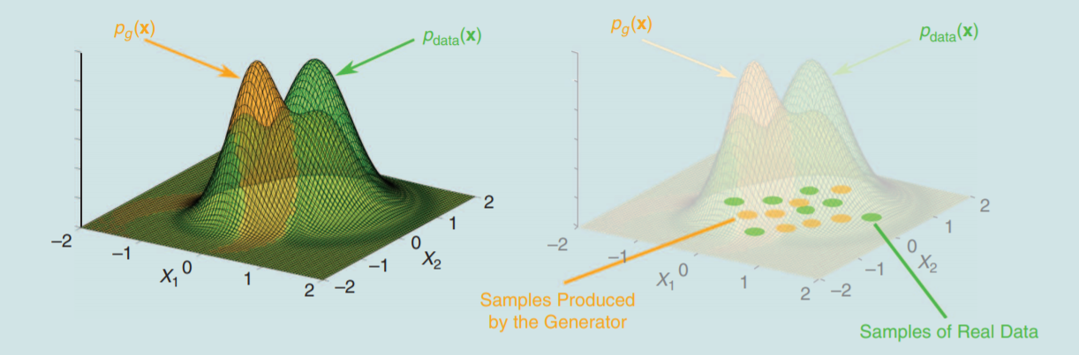
Generative algorithm wants to capture the probability distribution of data
Case1. Explicit density model
Density를 가정 (Gaussian, Poisson, …)
Train = Fitting parameter
MLE
Tractable but underfitting
Case2. Implicit density model
Density에 대한 가정 없음
주로 sampling 사용
MCMC
Generative model wants to make
probability distribution of model ($p_{model}(x)$) approximates that of data ($p_{data}(x)$).
$$p_{data}(x)≈p_{model}(x)$$
GAN
Parallelize / Flexible

Slide 7
Adversarial idea : Adversarial game and example
Adversarial game : Win of A is Loss of B (Zero-sum game)
vs

Slide 8
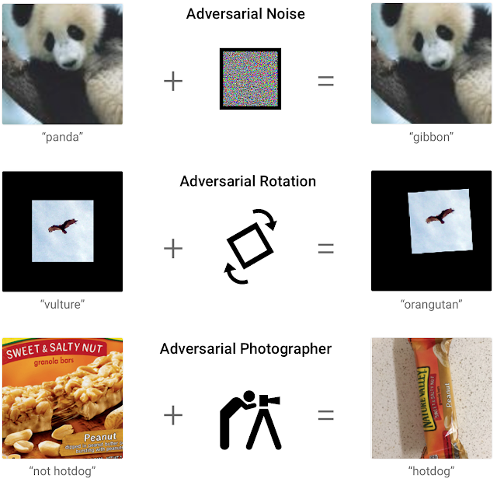
Adversarial idea : Adversarial game and example
Well categorized
(Obvious input)
Badly categorized
(Ambiguous input)
Adversarial example
: Slightly different example,
but not categorized well

Slide 9
Theory about GAN

Slide 10
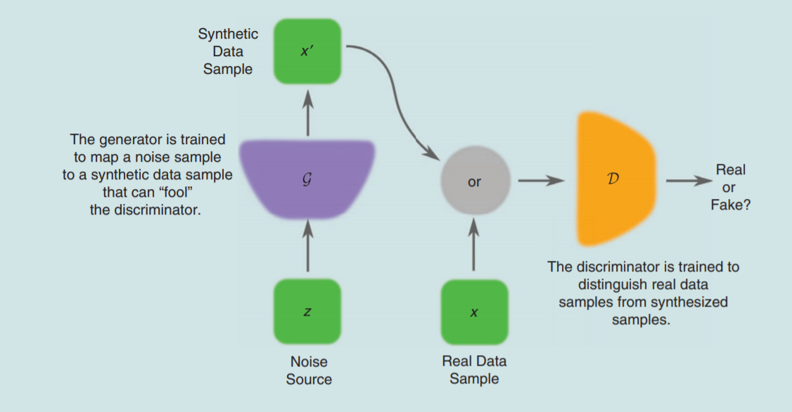
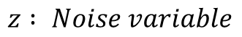
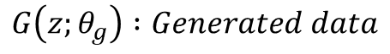
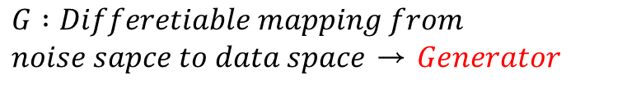
Objective function of GAN
$$z : Noise variable$$
$$G :Differetiable mapping from$$
$noise sapce to data space$ → $Generator$
$$G\left(z;θ_{g}\right) :Generated data$$
$$D :Binary classifier→Discriminator$$
$$D\left(x;θ_{d}\right) :scalr (probability of x from data)$$

Slide 11
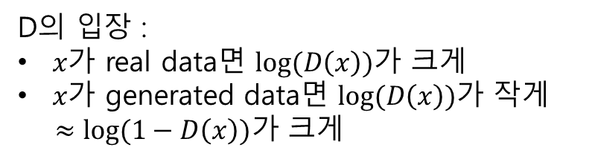
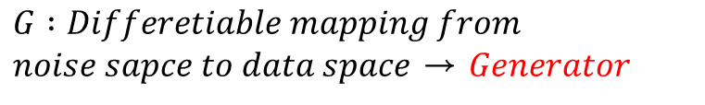
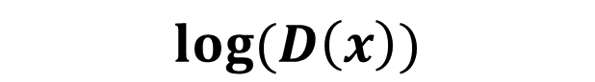
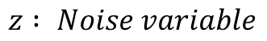
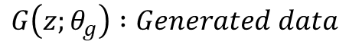
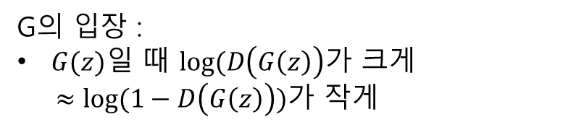
Objective function of GAN
$$z : Noise variable$$
$$log⁡(D\left(x\right))$$
$$G :Differetiable mapping from$$
$noise sapce to data space$ → $Generator$
D의 입장 :
$x가$ real data면 $log⁡(D\left(x\right))$가 크게
$x가$ generated data면 $log⁡(D\left(x\right))$가 작게
$≈log⁡(1−D\left(x\right))가$ 크게
$$G\left(z;θ_{g}\right) :Generated data$$
$$D :Binary classifier→Discrminator$$
G의 입장 :
$G(z)일$ 때 $log⁡(D\left(G\left(z\right)\right)가$ 크게
$≈log⁡(1−D\left(G\left(z\right)\right))$가 작게
$$D\left(x;θ_{d}\right) :scalr (probability of x from data)$$

Slide 12
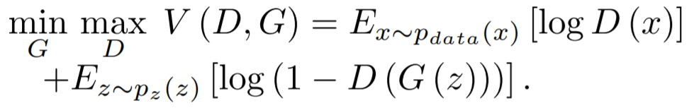
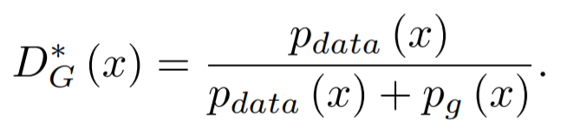
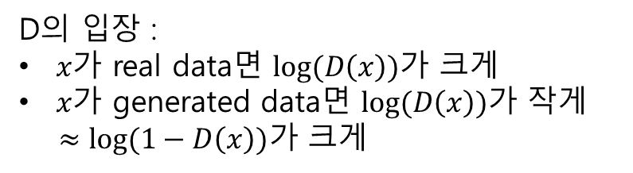
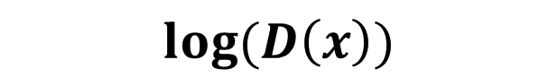
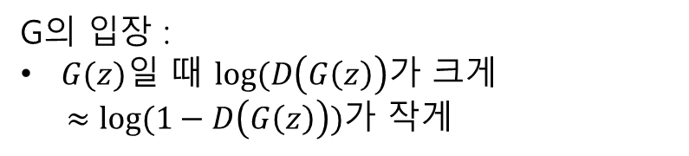
Objective function of GAN
$$log⁡(D\left(x\right))$$
Objective function of GAN
G와 관련 없음
D의 입장 :
$x가$ real data면 $log⁡(D\left(x\right))$가 크게
$x가$ generated data면 $log⁡(D\left(x\right))$가 작게
$≈log⁡(1−D\left(x\right))가$ 크게
G의 입장 :
$G(z)일$ 때 $log⁡(D\left(G\left(z\right)\right)가$ 크게
$≈log⁡(1−D\left(G\left(z\right)\right))$가 작게
When G is fixed

Slide 13
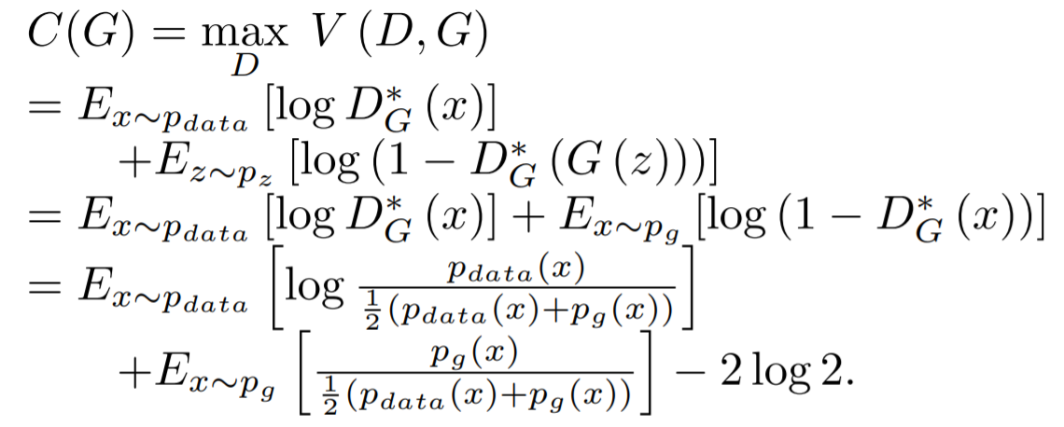
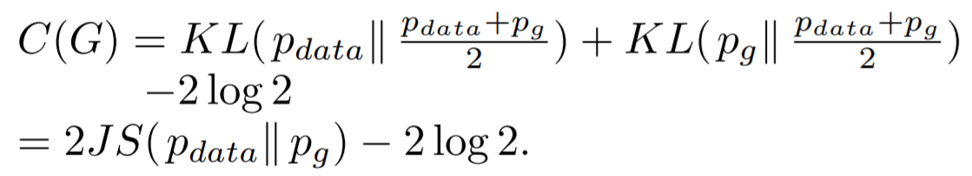
Objective function of GAN
Objective function of GAN
G와 관련 없음
When G is fixed
This is why GAN works!!

Slide 14
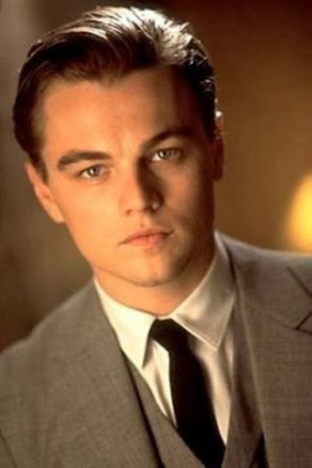
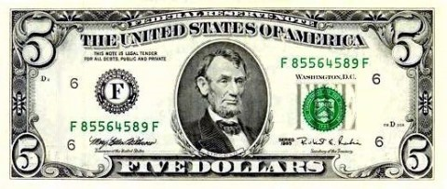
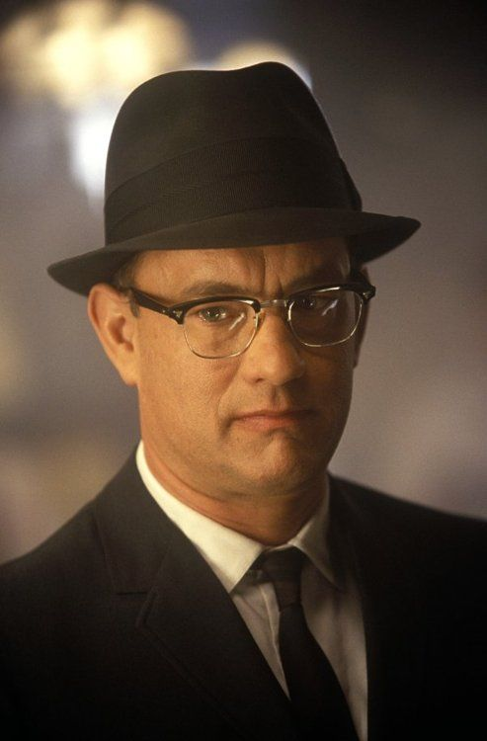


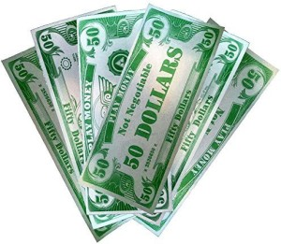

Real-world problem : Saturating game (Gradient vanishing)
<Pro-Forger>
<Pro-Discriminator>
<Amateur-Forger>
<Pro-Discriminator>

Slide 15
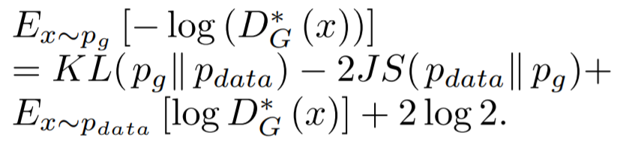
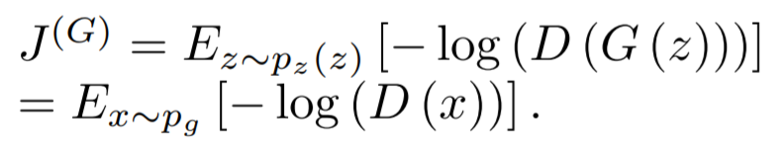
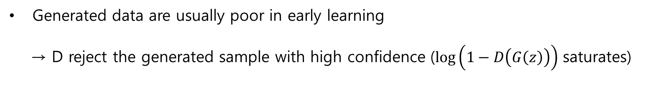
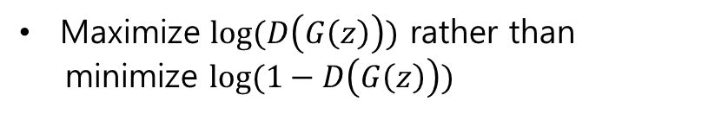
Real-world problem : Saturating game (Gradient vanishing)
Generated data are usually poor in early learning
→ D reject the generated sample with high confidence ($\log\left(1−D\left(G\left(z\right)\right)\right)$ saturates)
Non-saturating game
Maximize $log⁡(D\left(G\left(z\right)\right))$ rather than
minimize $log⁡(1−D\left(G\left(z\right)\right))$
KL and JS have different sign
KL is not symmetric
Much larger gradient in early learning
Unstable training (Mode collapse)

Slide 16
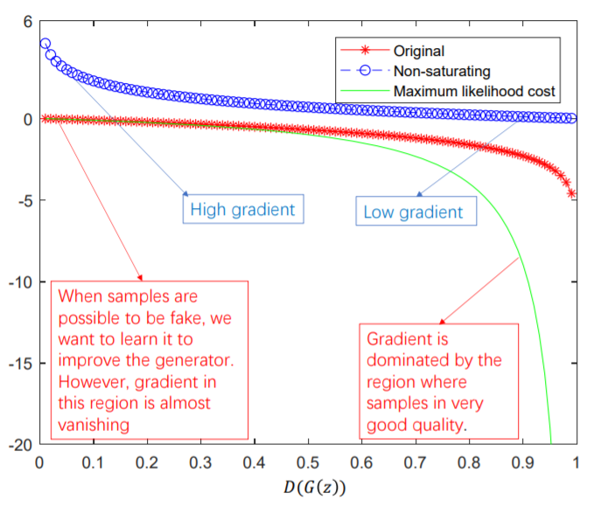
Real-world problem : Saturating game (Gradient vanishing)
No gradient vanishing & lower sample variance
→ Non-saturating game uses for real application
Poor generated data
Well generated data

Slide 17
Variants of GAN (Example)

Slide 18
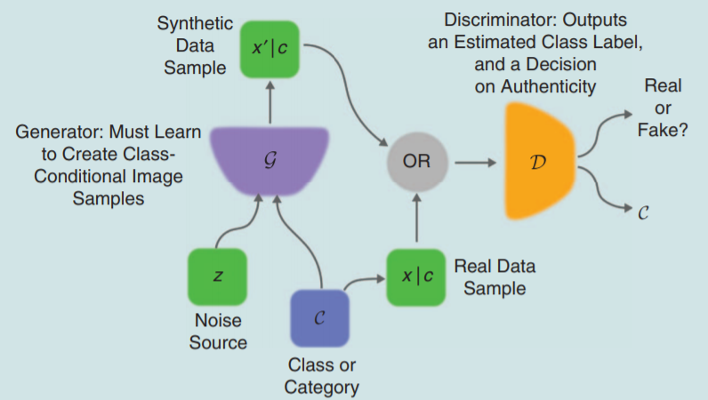
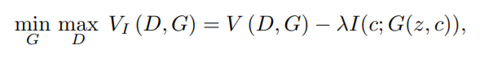
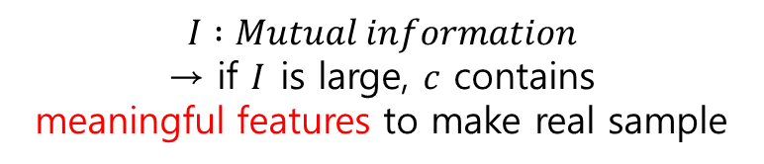
InfoGAN : GAN + Feature finding
Decompose noise vector into two parts
: (a) z : noise (b) c : latent code
$$I :Mutual information$$
→ if $I$ is large, $c$ contains
meaningful features to make real sample

Slide 19
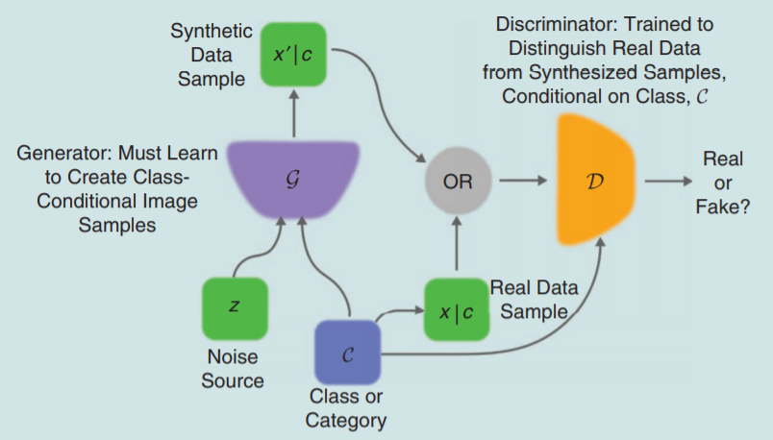
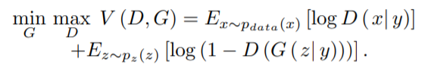
cGAN (Conditional Gan) : GAN + Mode
Extra information y

Slide 20
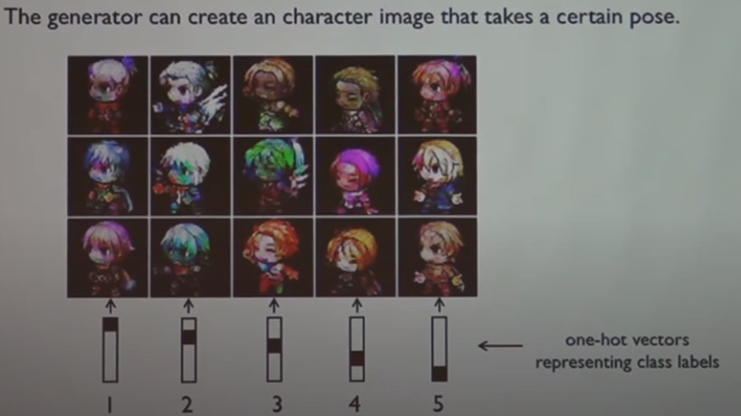
cGAN (Conditional Gan) : GAN + Mode
<SGAN>

Slide 21
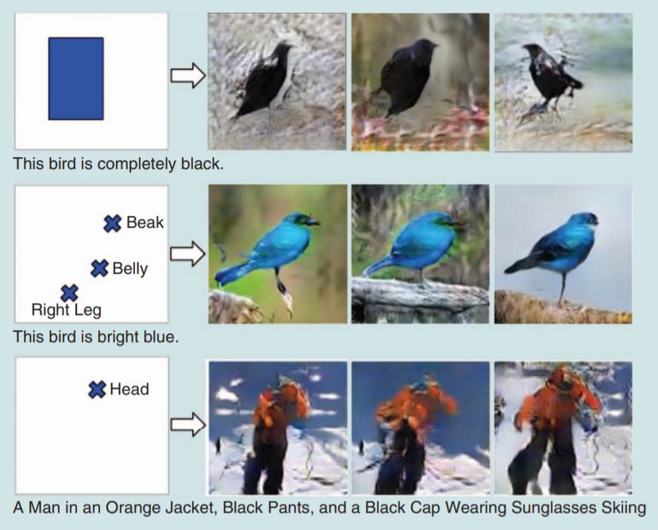
cGAN (Conditional Gan) : GAN + Mode
<GAWWN>

Slide 22
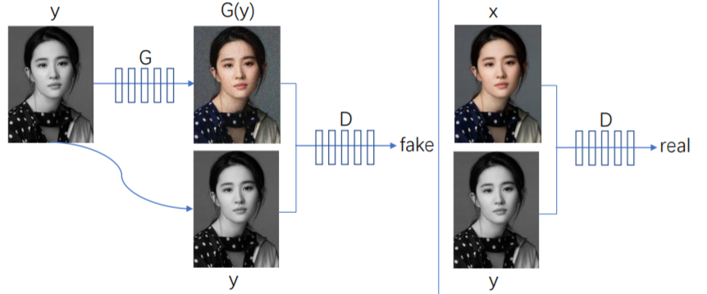
cGAN (Conditional Gan) : GAN + Mode
<pix2pix : No noise>

Slide 23
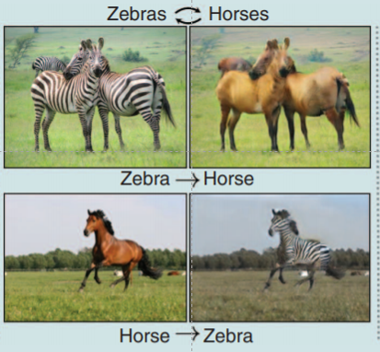
CycleGAN : Translate domain without changing feature
Image translation without “paired train sample”

Slide 24
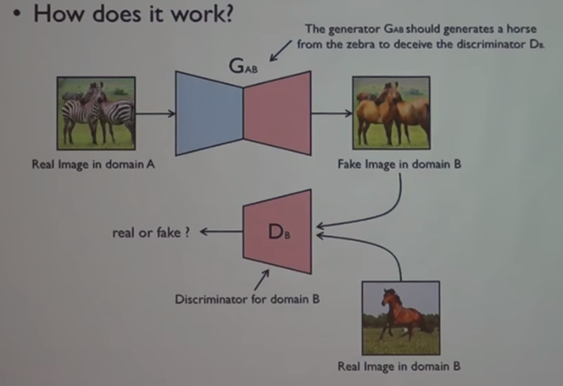
CycleGAN : Translate domain without changing feature

Slide 25
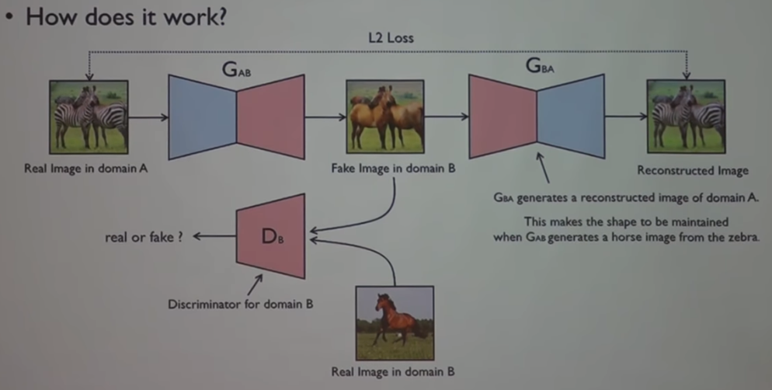
CycleGAN : Translate domain without changing feature

Slide 26
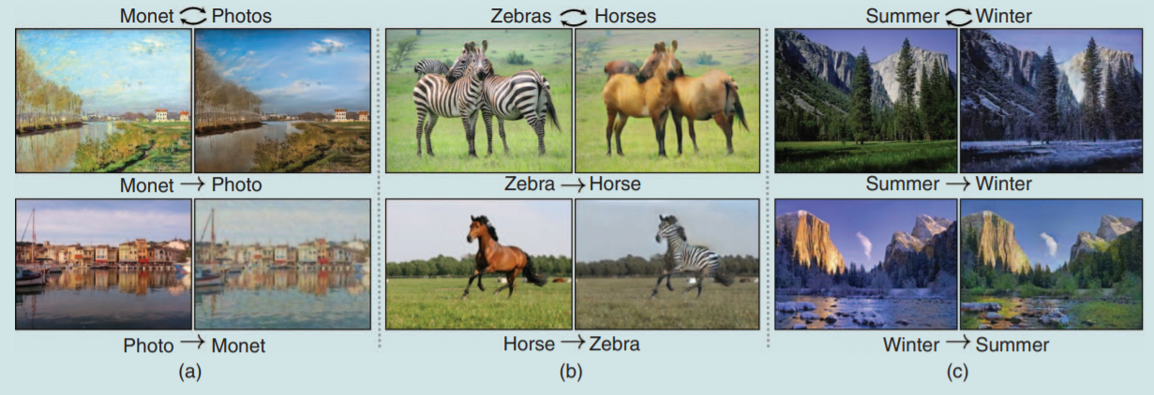
CycleGAN : Translate domain without changing feature
Image translation
Website “The GAN ZOO” for more variants

Slide 27
Variants of GAN (Theory)

Slide 28
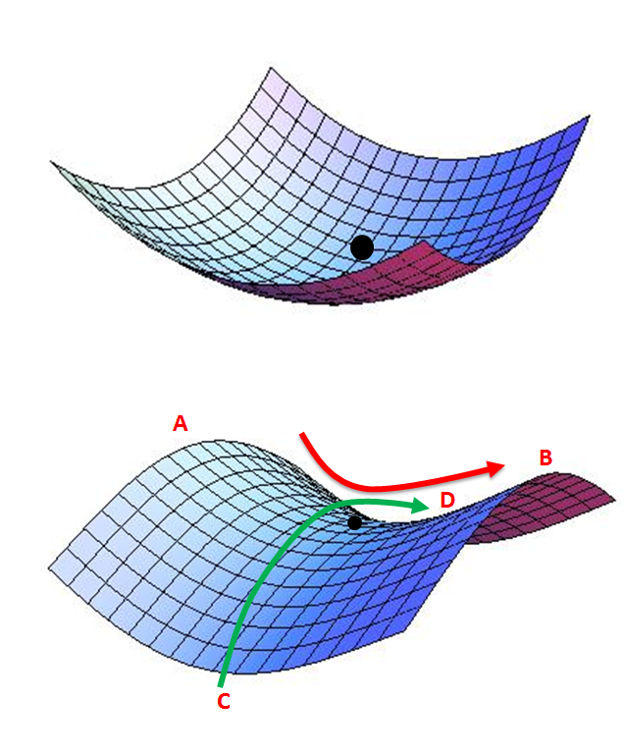
Objective function of GAN makes GAN unstable
Minima
Unstable
1) Gradient vanishing
2) Mode collapse
: Generate similar sample continuously
Saddle point

Slide 29
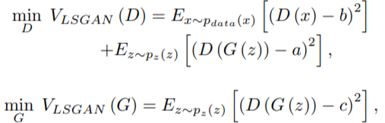
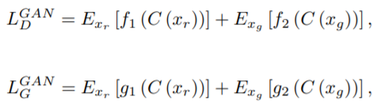
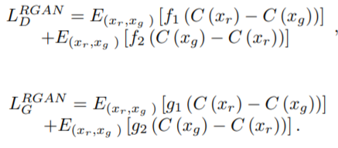
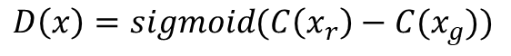

Changing objective function of GAN
1. Least squares GAN (LSGAN) : Use MSE rather than cross entropy + 너무 small error도 penalize
2. Relativistic GAN (RGAN) : Make layer of D with real / generated data pairs $\tilde{x}=(x_{r},x_{g})$
$$D\left(x\right)=sigmoid(C\left(x\right))$$
$$D\left(x\right)=sigmoid(C\left(x_{r}\right)−C(x_{g}))$$
(Probability that real sample is
more realistic than generated sample)

Slide 30


Changing structure : MLP to CNN or RNN
Original GAN : Use MLP for G and D → Use RNN (Text data) or CNN (Image data) to improve GAN
<LAPGAN>
<DCGAN>

Slide 31

Changing structure : MLP to CNN or RNN
Original GAN : Use MLP for G and D → Use RNN (Text data) or CNN (Image data) to improve GAN
<DCGAN>
<LAPGAN>

Slide 32


Changing structure : Inverse mapping using encoder
Original GAN : Cannot learn inverse mapping – projecting data back into latent space
<BiGAN / ALI>

Slide 33

Changing structure : Inverse mapping using encoder
Original GAN : Cannot learn inverse mapping – projecting data back into latent space
<BiGAN / ALI>

Slide 34
Task driven GAN

Slide 35




Semi-supervised learning and Transfer learning
$$p_{train}\left(x\right)≠p_{test}(x)$$
$GAN$을 통해 train sample을 많이 만든다.
$GAN$을 통해 domain adaptation
필요한 sample수가 매우 적어진다.
Use trained D as classifier

Slide 36

Multi-modal learning
Video의 다음 frame에서 face를 예측하자
: 답이 여러 개일 수 있다
GAN은 D만 속이면 모두 정답 (복수정답 인정)

Slide 37
Future work

Slide 38


Future work of GAN
Handle discrete data : G need to be differentiable
Evaluation metrics for GAN : ought to differentiate true samples from fake ones, verify mode drop, mode collapse, and detect overfitting
Stable training
Theory
Which assumption is sufficient to make $D$ converge to optimal $D^{∗}$?
How fast?

Slide 39

Reference
Jie Gui et. al, A Review on Generative Adversarial Networks: Algorithms, Theory, and Applications (2020)
Antonia Creswell et. al, Generative Adversarial Networks An overview (2018)
https://www.youtube.com/watch?v=odpjk7_tGY0

Slide 40

Done!!

